Slide 1
CUSTOMER BOOKING PREDICTIONS
WHAT INFLUENCES A CUSTOMERS DECISION TO BOOK?
OCTOBER 2023

Slide 2
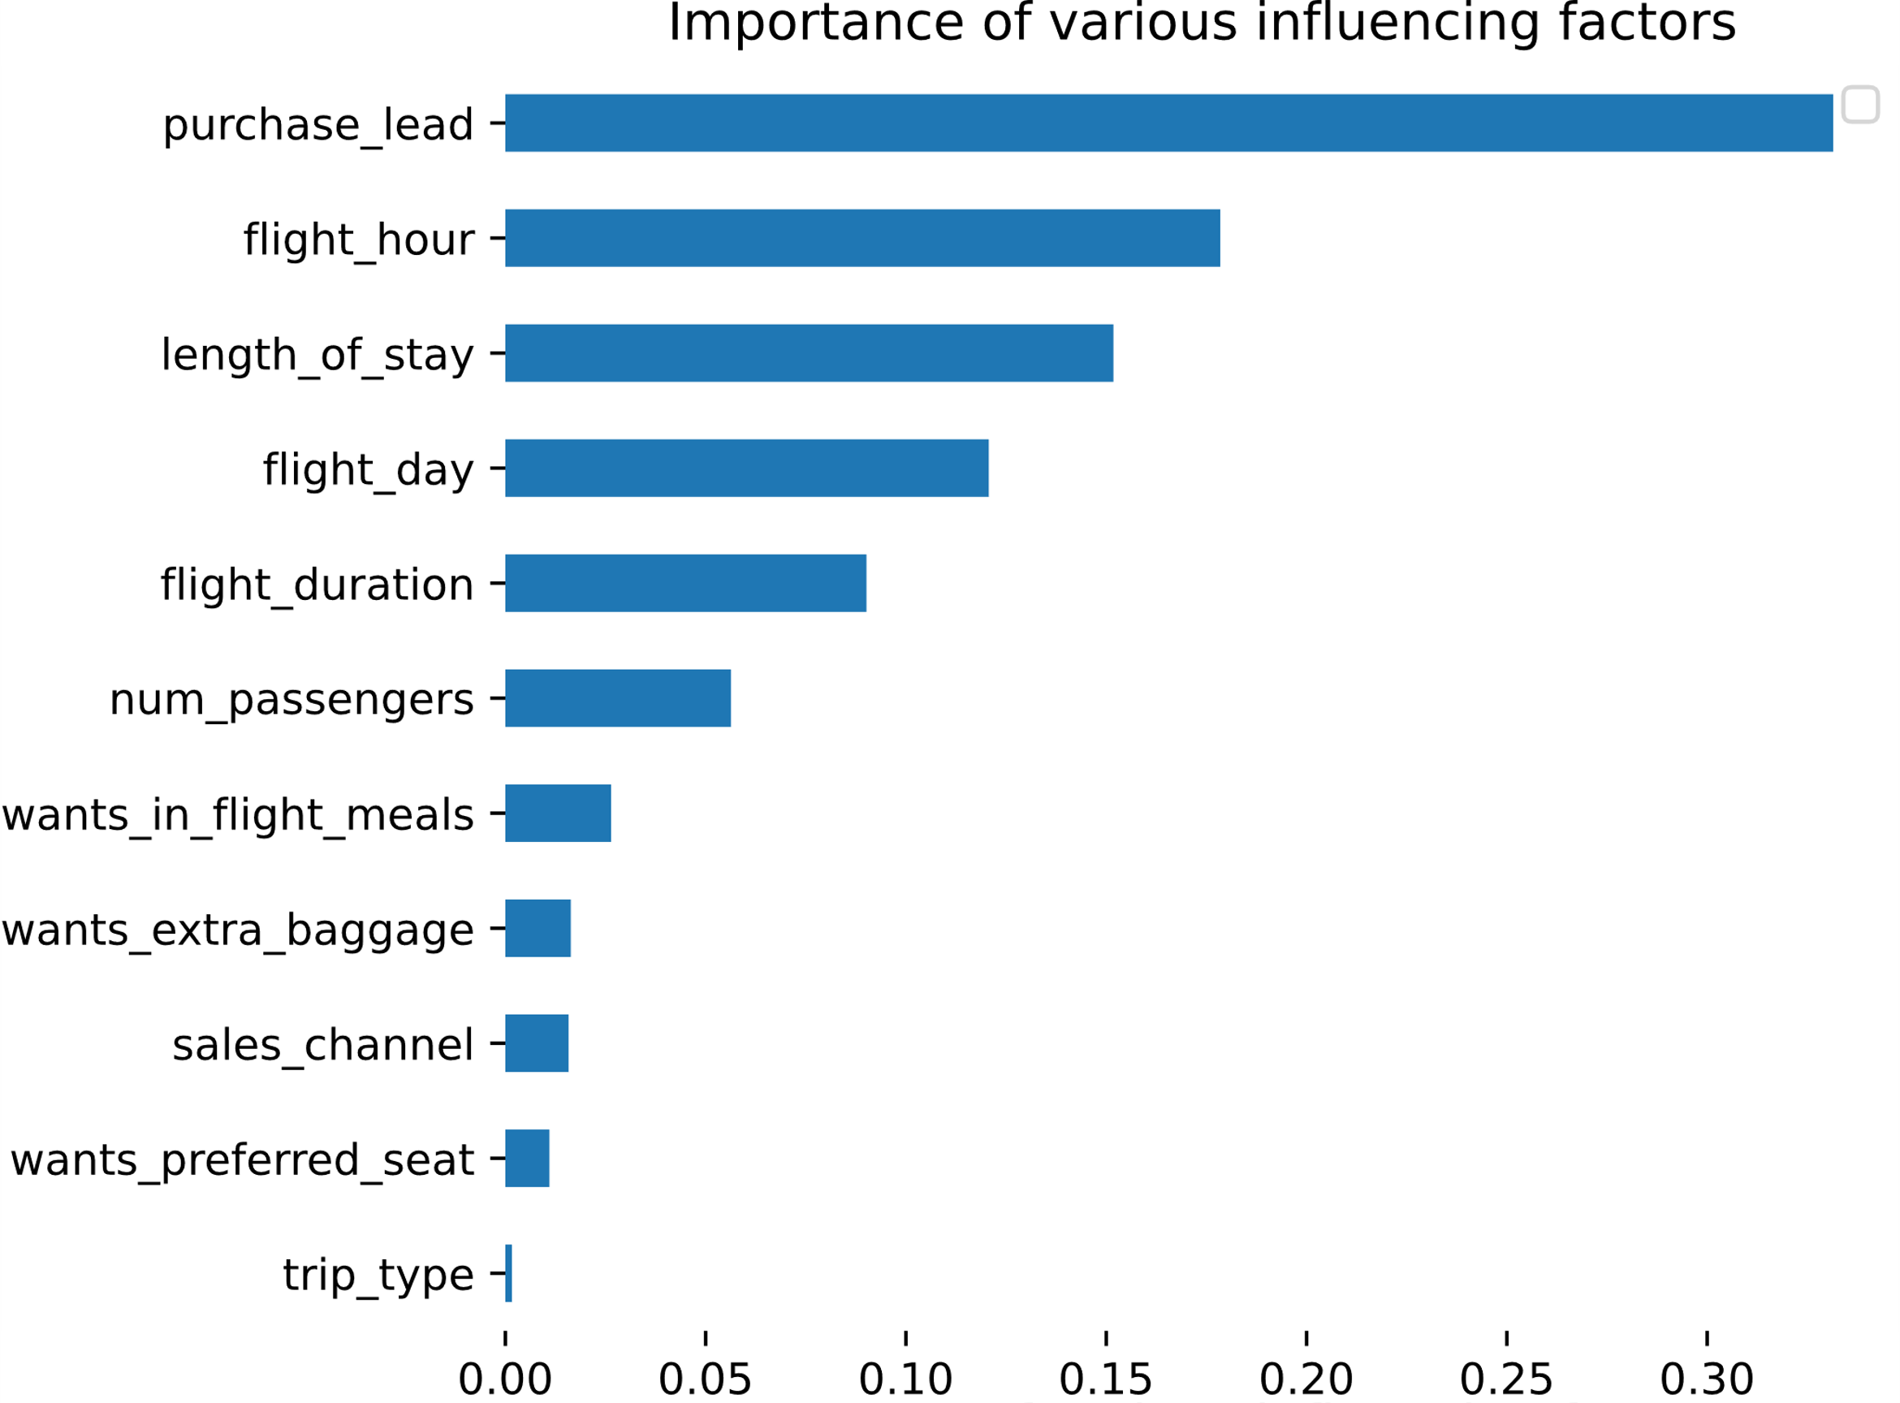
RESULTS FROM PREDICTION MODEL
EVALUATION
The most influential variable in our predictive model is the 'purchase lead’, which represents the time between purchase and flight departure.
The flight information is also important, that is flight hour (time of departure), flight day, and duration. The type of trip(round trip etc.) is insignificant.
Our model was able to achieve an accuracy of 0.76, which means it's correct 76% of the time. However, we have a recall of 0.24, indicating that we are only able to predict 24% of completed bookings. This is an issue because we're missing a significant portion of bookings that should have been marked as 'completed’. Overall, our model has a ROC AUC of 0.54, which means it's better than random guessing, but there is still room for improvement. Although it's somewhat effective at distinguishing between completed and non-completed bookings, it's not doing so as well as we'd like.
To enhance our model's performance, I suggest incorporating more customer-facing data.

